Slide 1

28th February –7th MARCH 2025
Topic modelling
With lda
Instructor: Xandra Dave Cochran

Slide 2




Topic Modelling
Unsupervised Machine Learning
www.cdcs.ed.ac.uk

Slide 3
Topic Modelling
Unsupervised Machine Learning
Identifies clusters of related words in text
www.cdcs.ed.ac.uk

Slide 4
Topic Modelling
Unsupervised Machine Learning
Identifies clusters of related words in text
Does not require predefined categories – good for discovery and exploration of a dataset
www.cdcs.ed.ac.uk

Slide 5

INTRODUCTIONS
Is there anyone here today that wasn’t here for BERTopic last week? If so – HELLO! Welcome! And…
www.cdcs.ed.ac.uk

Slide 6
INTRODUCTIONS
Is there anyone here today that wasn’t here for BERTopic last week? If so – HELLO! Welcome! And…
What is your previous experience with machine learning?
Why are you interested in topic modelling?
Have you used LLMs before?
Is there a dataset you have in mind to use for topic modelling in future?
www.cdcs.ed.ac.uk

Slide 7
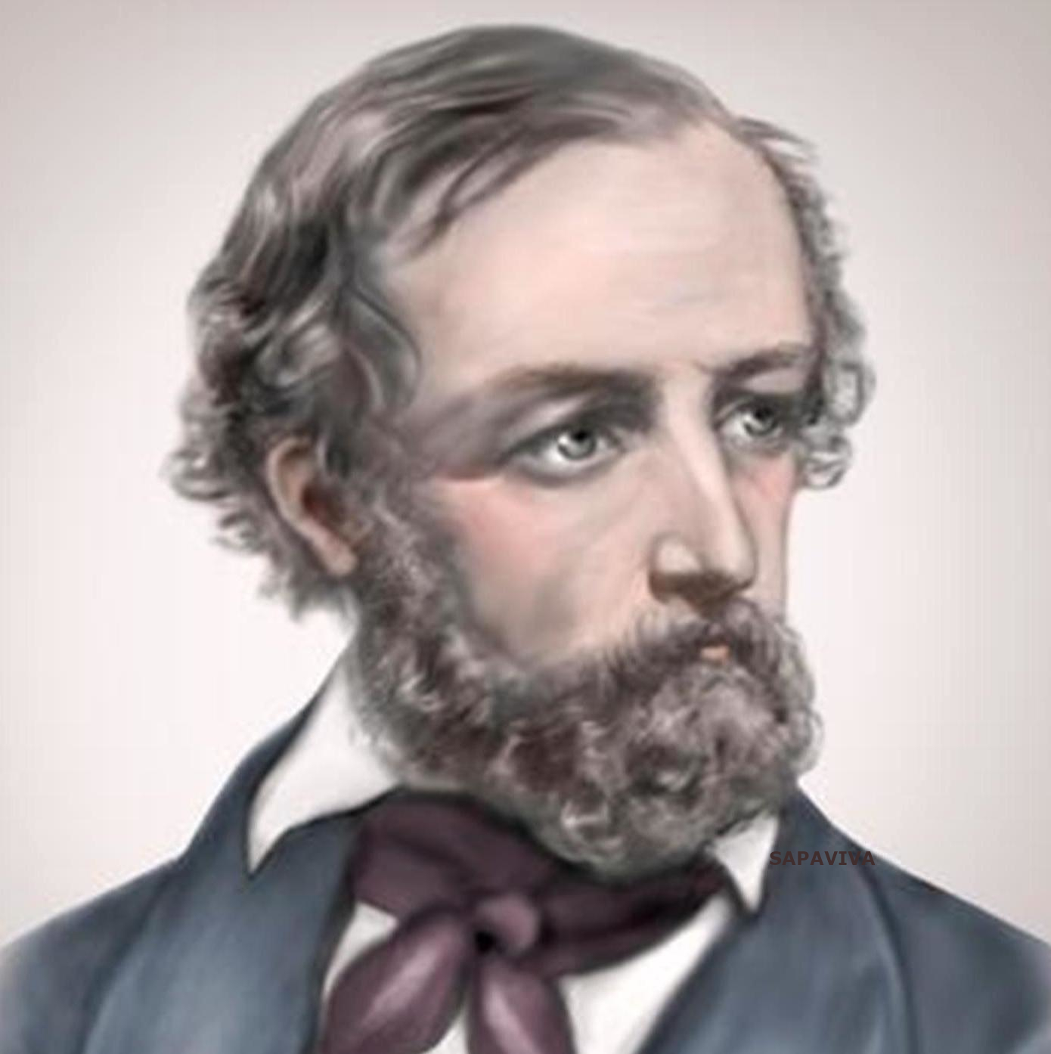
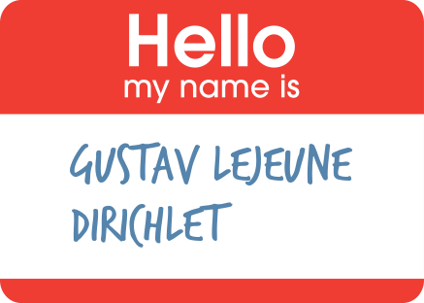
Latent Dirichlet Allocation
This is a rather more old-school model than BERTopic – introduced by Blei, Ng & Jordan in 2003
www.cdcs.ed.ac.uk

Slide 8
Latent Dirichlet Allocation
This is a rather more old-school model than BERTopic – introduced by Blei, Ng & Jordan in 2003
No billion-parameter neural networks here: the model is simpler & and, arguably, it’s easier to interpret its outputs (eXplainable AI – XAI)
www.cdcs.ed.ac.uk

Slide 9
Latent Dirichlet Allocation
This is a rather more old-school model than BERTopic – introduced by Blei, Ng & Jordan in 2003
No billion-parameter neural networks here: the model is simpler & and, arguably, it’s easier to interpret its outputs (eXplainable AI – XAI)
But is it as good?
www.cdcs.ed.ac.uk

Slide 10
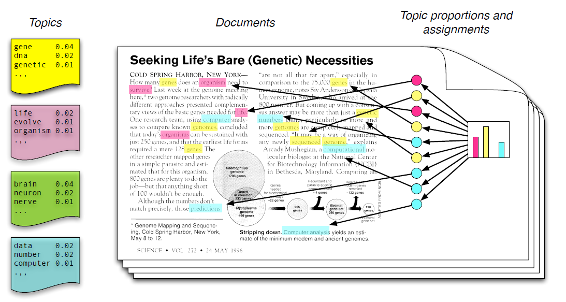
Latent Dirichlet Allocation
Topics are vectors of probabilities of words
www.cdcs.ed.ac.uk

Slide 11
Latent Dirichlet Allocation
Topics are vectors of probabilities of words
A document may be a blend of multiple topics
www.cdcs.ed.ac.uk

Slide 12
Latent Dirichlet Allocation
Topics are vectors of probabilities of words
A document may be a blend of multiple topics
The model makes use of Dirichlet Distributions to model the relations from Topics to Documents and Words to Topics…
www.cdcs.ed.ac.uk

Slide 13

Latent Dirichlet Allocation
An LDA is a generative model
music
music
food
data
science
data
science
food
coffee
coffee
www.cdcs.ed.ac.uk

Slide 14
Latent Dirichlet Allocation
An LDA is a generative model…
But what does it generate?
music
music
food
data
science
data
science
food
coffee
coffee
www.cdcs.ed.ac.uk

Slide 15
Latent Dirichlet Allocation
An LDA is a generative model…
But what does it generate?
Documents?
music
music
food
data
science
data
science
food
coffee
coffee
www.cdcs.ed.ac.uk

Slide 16
Latent Dirichlet Allocation
An LDA is a generative model…
But what does it generate?
Documents?
Well, sort of…
music
music
food
data
science
data
science
food
coffee
coffee
www.cdcs.ed.ac.uk

Slide 17
Bag of Words
We simplify the data by throwing out word order and just considering the number of occurrences of each word in a document
www.cdcs.ed.ac.uk
Notes:
Building capacity in the Digital Humanities
The Digital Research Infrastructure for the Arts and Humanities (DARIAH) aims to enhance and support digitally-enabled research and teaching across the arts and humanities. DARIAH is a network of people, expertise, information, knowledge, content, methods, tools and technologies from its member countries. It develops, maintains and operates an infrastructure in support of ICT-based research practices and sustains researchers in using them to build, analyse and interpret digital resources. By working with communities of practice, DARIAH brings together individual state-of-the-art digital arts and humanities activities and scales their results to a European level. It preserves, provides access to and disseminates research that stems from these collaborations and ensures that best practices, methodological and technical standards are followed.

Slide 18
Bag of Words
We simplify the data by throwing out word order and just considering the number of occurrences of each word in a document
We also ignore stop-words like ‘and’, ‘is’, etc
www.cdcs.ed.ac.uk
Notes:
Building capacity in the Digital Humanities
The Digital Research Infrastructure for the Arts and Humanities (DARIAH) aims to enhance and support digitally-enabled research and teaching across the arts and humanities. DARIAH is a network of people, expertise, information, knowledge, content, methods, tools and technologies from its member countries. It develops, maintains and operates an infrastructure in support of ICT-based research practices and sustains researchers in using them to build, analyse and interpret digital resources. By working with communities of practice, DARIAH brings together individual state-of-the-art digital arts and humanities activities and scales their results to a European level. It preserves, provides access to and disseminates research that stems from these collaborations and ensures that best practices, methodological and technical standards are followed.

Slide 19
Bag of Words
We simplify the data by throwing out word order and just considering the number of occurrences of each word in a document
We also ignore stop-words like ‘and’, ‘is’, etc
Also numbers, links, punctuation, etc
www.cdcs.ed.ac.uk
Notes:
Building capacity in the Digital Humanities
The Digital Research Infrastructure for the Arts and Humanities (DARIAH) aims to enhance and support digitally-enabled research and teaching across the arts and humanities. DARIAH is a network of people, expertise, information, knowledge, content, methods, tools and technologies from its member countries. It develops, maintains and operates an infrastructure in support of ICT-based research practices and sustains researchers in using them to build, analyse and interpret digital resources. By working with communities of practice, DARIAH brings together individual state-of-the-art digital arts and humanities activities and scales their results to a European level. It preserves, provides access to and disseminates research that stems from these collaborations and ensures that best practices, methodological and technical standards are followed.

Slide 20
Bag of Words
We simplify the data by throwing out word order and just considering the number of occurrences of each word in a document
We also ignore stop-words like ‘and’, ‘is’, etc
Also numbers, links, punctuation, etc
Also anything else we think is going to be frequent across all documents – like ‘UN’ in a corpus of UN tweets
www.cdcs.ed.ac.uk
Notes:
Building capacity in the Digital Humanities
The Digital Research Infrastructure for the Arts and Humanities (DARIAH) aims to enhance and support digitally-enabled research and teaching across the arts and humanities. DARIAH is a network of people, expertise, information, knowledge, content, methods, tools and technologies from its member countries. It develops, maintains and operates an infrastructure in support of ICT-based research practices and sustains researchers in using them to build, analyse and interpret digital resources. By working with communities of practice, DARIAH brings together individual state-of-the-art digital arts and humanities activities and scales their results to a European level. It preserves, provides access to and disseminates research that stems from these collaborations and ensures that best practices, methodological and technical standards are followed.

Slide 21
Bag of Words
We simplify the data by throwing out word order and just considering the number of occurrences of each word in a document
We also ignore stop-words like ‘and’, ‘is’, etc
Also numbers, links, punctuation, etc
Also anything else we think is going to be frequent across all documents – like ‘UN’ in a corpus of UN tweets
From the point of view of LDA, a document is just a bag of words
www.cdcs.ed.ac.uk
Notes:
Building capacity in the Digital Humanities
The Digital Research Infrastructure for the Arts and Humanities (DARIAH) aims to enhance and support digitally-enabled research and teaching across the arts and humanities. DARIAH is a network of people, expertise, information, knowledge, content, methods, tools and technologies from its member countries. It develops, maintains and operates an infrastructure in support of ICT-based research practices and sustains researchers in using them to build, analyse and interpret digital resources. By working with communities of practice, DARIAH brings together individual state-of-the-art digital arts and humanities activities and scales their results to a European level. It preserves, provides access to and disseminates research that stems from these collaborations and ensures that best practices, methodological and technical standards are followed.

Slide 22
The Dirichlet Distribution
An Dirichlet Distribution is a generative model…
code
java
coffee
animals
crab
python
espresso
coffee
www.cdcs.ed.ac.uk

Slide 23
The Dirichlet Distribution
An Dirichlet Distribution is a generative model…
But what does it generate?
code
java
coffee
animals
crab
python
espresso
coffee
www.cdcs.ed.ac.uk

Slide 24
The Dirichlet Distribution
An Dirichlet Distribution is a generative model…
But what does it generate?
Categorical events, which we represent as vertices of an equilateral triangle
www.cdcs.ed.ac.uk

Slide 25
The Dirichlet Distribution
An Dirichlet Distribution is a generative model…
But what does it generate?
Categorical events, which we represent as vertices of an equilateral triangle
Or a regular tetrahedron
coffee
www.cdcs.ed.ac.uk

Slide 26

The Dirichlet Distribution
An Dirichlet Distribution is a generative model…
But what does it generate?
Categorical events, which we represent as vertices of an equilateral triangle
Or a regular tetrahedron
Or any of their higher-dimensional relatives (simplices)
Image not found
coffee
www.cdcs.ed.ac.uk

Slide 27
The Dirichlet Distribution
An Dirichlet Distribution is a generative model…
But what does it generate?
Categorical events, which we represent as vertices of an equilateral triangle
Or a regular tetrahedron
Or any of their higher-dimensional relatives (simplices)
Image not found
Image not found
coffee
www.cdcs.ed.ac.uk

Slide 28
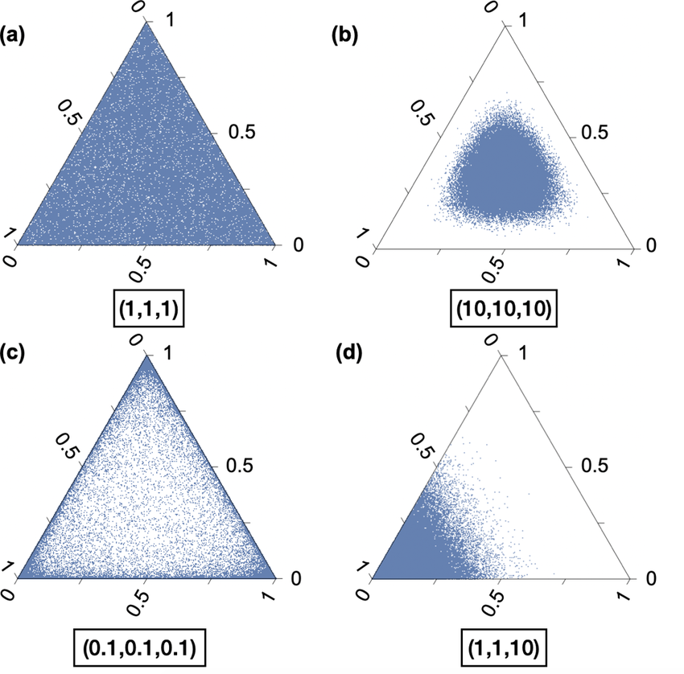
The Dirichlet Distribution is a Probability Density Function
With k options, the distribution is parametrised by a vector 𝛼 of length k
www.cdcs.ed.ac.uk

Slide 29
The Dirichlet Distribution is a Probability Density Function
With k options, the distribution is parametrised by a vector 𝛼 of length k
Values of 𝛼 less than 1 concentrate the probability density at the corners, and greater than 1 concentrate it at the centre
www.cdcs.ed.ac.uk

Slide 30
The Dirichlet Distribution is a Probability Density Function
With k options, the distribution is parametrised by a vector 𝛼 of length k
Values of 𝛼 less than 1 concentrate the probability density at the corners, and greater than 1 concentrate it at the centre
Each point in the simplex corresponds to another PDF: a multinomial distribution, with probabilities of each event proportionate to the distance to the corresponding vertex
www.cdcs.ed.ac.uk

Slide 31
Latent Dirichlet Assignment
An LDA generates bags-of words. Each word is generated by sampling two Dirichlet distributions
coffee
www.cdcs.ed.ac.uk

Slide 32
Latent Dirichlet Assignment
An LDA generates bags-of words. Each word is generated by sampling two Dirichlet distributions
The first is topics per document: for each document, this distribution is sampled to generate a multinomial distribution of topics. (a document may contain multiple topics)
code
coffee
animals
coffee
www.cdcs.ed.ac.uk

Slide 33
Latent Dirichlet Assignment
An LDA generates bags-of words. Each word is generated by sampling two Dirichlet distributions
The first is topics per document: for each document, this distribution is sampled to generate a multinomial distribution of topics. (a document may contain multiple topics)
code
P(coffee) =0.65
P(animals) = 0.3
P(code) =0.05
coffee
coffee
animals
coffee
www.cdcs.ed.ac.uk

Slide 34
Latent Dirichlet Assignment
An LDA generates bags-of words. Each word is generated by sampling two Dirichlet distributions
The first is topics per document: for each document, this distribution is sampled to generate a multinomial distribution of topics. (a document may contain multiple topics)
code
P(coffee) =0.65
P(animals) = 0.3
P(code) =0.05
coffee
coffee
coffee
animals
coffee
www.cdcs.ed.ac.uk

Slide 35
Latent Dirichlet Assignment
An LDA generates bags-of words. Each word is generated by sampling two Dirichlet distributions
The first is topics per document: for each document, this distribution is sampled to generate a multinomial distribution of topics. (a document may contain multiple topics)
code
P(coffee) =0.65
P(animals) = 0.3
P(code) =0.05
coffee
coffee
animals
coffee
animals
coffee
www.cdcs.ed.ac.uk

Slide 36
Latent Dirichlet Assignment
An LDA generates bags-of words. Each word is generated by sampling two Dirichlet distributions
The first is topics per document: for each document, this distribution is sampled to generate a multinomial distribution of topics. (a document may contain multiple topics)
code
P(coffee) =0.65
P(animals) = 0.3
P(code) =0.05
coffee
coffee
animals
coffee
coffee
animals
coffee
www.cdcs.ed.ac.uk

Slide 37
Latent Dirichlet Assignment
An LDA generates bags-of words. Each word is generated by sampling two Dirichlet distributions
The first is topics per document: for each document, this distribution is sampled to generate a multinomial distribution of topics. (a document may contain multiple topics)
code
P(coffee) =0.65
P(animals) = 0.3
P(code) =0.05
coffee
coffee
animals
coffee
animals
coffee
animals
coffee
www.cdcs.ed.ac.uk

Slide 38
Latent Dirichlet Assignment
An LDA generates bags-of words. Each word is generated by sampling two Dirichlet distributions
The first is topics per document: for each document, this distribution is sampled to generate a multinomial distribution of topics. (a document may contain multiple topics)
code
P(coffee) =0.65
P(animals) = 0.3
P(code) =0.05
coffee
coffee
animals
coffee
animals
coffee
coffee
animals
coffee
www.cdcs.ed.ac.uk

Slide 39
Latent Dirichlet Assignment
An LDA generates bags-of words. Each word is generated by sampling two Dirichlet distributions
The first is topics per document: for each document, this distribution is sampled to generate a multinomial distribution of topics. (a document may contain multiple topics)
code
P(coffee) =0.65
P(animals) = 0.3
P(code) =0.05
coffee
coffee
animals
coffee
animals
coffee
coffee
coffee
animals
coffee
www.cdcs.ed.ac.uk

Slide 40
Latent Dirichlet Assignment
An LDA generates bags-of words. Each word is generated by sampling two Dirichlet distributions
The first is topics per document: for each document, this distribution is sampled to generate a multinomial distribution of topics. (a document may contain multiple topics)
code
P(coffee) =0.65
P(animals) = 0.3
P(code) =0.05
coffee
coffee
animals
coffee
animals
coffee
coffee
code
coffee
animals
coffee
www.cdcs.ed.ac.uk

Slide 41
Latent Dirichlet Assignment
An LDA generates bags-of words. Each word is generated by sampling two Dirichlet distributions
The first is topics per document: for each document, this distribution is sampled to generate a multinomial distribution of topics. (a document may contain multiple topics)
code
P(coffee) =0.65
P(animals) = 0.3
P(code) =0.05
coffee
coffee
animals
coffee
animals
coffee
coffee
code
coffee
coffee
animals
www.cdcs.ed.ac.uk

Slide 42
Latent Dirichlet Assignment
An LDA generates bags-of words. Each word is generated by sampling two Dirichlet distributions
The first is topics per document: it is repeatedly sampled to generate the mixture of topics in the document. (a document may contain multiple topics)
The second is words per topic: the events at the vertices are words, and each topic is a point in the simplex
P(coffee) =0.65
P(animals) = 0.3
P(code) =0.05
coffee
coffee
animals
coffee
animals
coffee
coffee
code
coffee
coffee
animals
java
P(espresso|coffee) = 0.5
P(java|coffee) = 0.4
P(crab|coffee) = 0.05
P(python|coffee) = 0.5
crab
python
coffee
coffee
espresso
www.cdcs.ed.ac.uk

Slide 43
Latent Dirichlet Assignment
An LDA generates bags-of words. Each word is generated by sampling two Dirichlet distributions
The first is topics per document: it is repeatedly sampled to generate the mixture of topics in the document. (a document may contain multiple topics)
The second is words per topic: the events at the vertices are words, and each topic is a point in the simplex
P(coffee) =0.65
P(animals) = 0.3
P(code) =0.05
coffee
coffee
animals
coffee
animals
coffee
coffee
code
coffee
coffee
animals
espresso
java
P(espresso|coffee) = 0.5
P(java|coffee) = 0.4
P(crab|coffee) = 0.05
P(python|coffee) = 0.5
crab
python
coffee
coffee
espresso
www.cdcs.ed.ac.uk

Slide 44
Latent Dirichlet Assignment
An LDA generates bags-of words. Each word is generated by sampling two Dirichlet distributions
The first is topics per document: it is repeatedly sampled to generate the mixture of topics in the document. (a document may contain multiple topics)
The second is words per topic: the events at the vertices are words, and each topic is a point in the simplex
P(coffee) =0.65
P(animals) = 0.3
P(code) =0.05
coffee
coffee
animals
coffee
animals
coffee
coffee
code
coffee
coffee
animals
espresso
java
java
P(espresso|coffee) = 0.5
P(java|coffee) = 0.4
P(crab|coffee) = 0.05
P(python|coffee) = 0.5
crab
python
coffee
coffee
espresso
www.cdcs.ed.ac.uk

Slide 45
Latent Dirichlet Assignment
An LDA generates bags-of words. Each word is generated by sampling two Dirichlet distributions
The first is topics per document: it is repeatedly sampled to generate the mixture of topics in the document. (a document may contain multiple topics)
The second is words per topic: the events at the vertices are words, and each topic is a point in the simplex
P(coffee) =0.65
P(animals) = 0.3
P(code) =0.05
coffee
coffee
animals
coffee
animals
coffee
coffee
code
coffee
coffee
animals
espresso
java
java
P(espresso|coffee) = 0.5
P(java|coffee) = 0.4
P(crab|coffee) = 0.05
P(python|coffee) = 0.5
crab
python
coffee
coffee
espresso
www.cdcs.ed.ac.uk

Slide 46
Latent Dirichlet Assignment
An LDA generates bags-of words. Each word is generated by sampling two Dirichlet distributions
The first is topics per document: it is repeatedly sampled to generate the mixture of topics in the document. (a document may contain multiple topics)
The second is words per topic: the events at the vertices are words, and each topic is a point in the simplex
P(coffee) =0.65
P(animals) = 0.3
P(code) =0.05
coffee
coffee
animals
coffee
animals
coffee
coffee
code
coffee
coffee
animals
espresso
java
crab
java
P(espresso|coffee) = 0.07
P(java|coffee) = 0.03
P(crab|coffee) = 0.6
P(python|coffee) = 0.3
crab
python
coffee
coffee
espresso
www.cdcs.ed.ac.uk

Slide 47
Latent Dirichlet Assignment
An LDA generates bags-of words. Each word is generated by sampling two Dirichlet distributions
The first is topics per document: it is repeatedly sampled to generate the mixture of topics in the document. (a document may contain multiple topics)
The second is words per topic: the events at the vertices are words, and each topic is a point in the simplex
P(coffee) =0.65
P(animals) = 0.3
P(code) =0.05
coffee
coffee
animals
coffee
animals
coffee
coffee
code
coffee
coffee
animals
espresso
java
crab
…
etc
…
java
P(espresso|coffee) = 0.5
P(java|coffee) = 0.4
P(crab|coffee) = 0.05
P(python|coffee) = 0.5
crab
python
coffee
coffee
espresso
www.cdcs.ed.ac.uk

Slide 48
Latent Dirichlet Assignment
The goal isn’t actually to generate bags of words here: rather, it is to assign probabilities to bags of words, given a particular set of parameters that tune the behaviour of the LDA
P(coffee) =0.65
P(animals) = 0.3
P(code) =0.05
coffee
coffee
animals
coffee
animals
coffee
coffee
code
coffee
coffee
animals
espresso
java
crab
…
etc
…
java
P(espresso|coffee) = 0.5
P(java|coffee) = 0.4
P(crab|coffee) = 0.05
P(python|coffee) = 0.5
crab
python
coffee
coffee
espresso
www.cdcs.ed.ac.uk

Slide 49
Latent Dirichlet Assignment
The goal isn’t actually to generate bags of words here: rather, it is to assign probabilities to bags of words, given a particular set of parameters that tune the behaviour of the LDA
The goal of training an LDA, given a set of training data (we will use a collection of UN Human Rights tweets), is to find the parameter values that maximise the probability that the LDA might generate exactly the data in your training set. But how?
P(coffee) =0.65
P(animals) = 0.3
P(code) =0.05
coffee
coffee
animals
coffee
animals
coffee
coffee
code
coffee
coffee
animals
espresso
java
crab
…
etc
…
java
P(espresso|coffee) = 0.5
P(java|coffee) = 0.4
P(crab|coffee) = 0.05
P(python|coffee) = 0.5
crab
python
coffee
coffee
espresso
www.cdcs.ed.ac.uk

Slide 50
Documents…
Gibbs Sampling
Set the hyperparameter k as the number of topics. (How? Guess!)
java
python
java
java
espresso
python
c++
cake
java
espresso
aeropress
espresso
café
espresso
latte
espresso
café
paris
zurich
ball
arp
dada
dada
dada
ball
team
goal
team
ball
goal
kick
win
team
motivate
goal
manage
team
manage
pizza
quarterly
coffee
coffee
www.cdcs.ed.ac.uk

Slide 51
Documents…
Gibbs Sampling
Set the hyperparameter k as the number of topics. (How? Guess!)
Create k arbitrary topics, and assign a topic at random to each word-instance in each document.
java
python
java
java
espresso
python
c++
cake
java
espresso
aeropress
espresso
café
espresso
latte
espresso
café
paris
zurich
ball
arp
dada
dada
dada
ball
team
goal
team
ball
goal
kick
win
team
motivate
goal
manage
team
manage
pizza
quarterly
coffee
coffee
www.cdcs.ed.ac.uk

Slide 52
Documents…
Gibbs Sampling
Set the hyperparameter k as the number of topics. (How? Guess!)
Create k arbitrary topics, and assign a topic at random to each word-instance in each document.
java
python
java
java
espresso
python
c++
cake
java
espresso
aeropress
espresso
café
espresso
latte
espresso
café
paris
zurich
ball
arp
dada
dada
dada
ball
team
goal
team
ball
goal
kick
win
team
motivate
goal
manage
team
manage
pizza
quarterly
Topics, with k = 3
coffee
coffee
www.cdcs.ed.ac.uk

Slide 53
Documents…
Gibbs Sampling
Set the hyperparameter k as the number of topics. (How? Guess!)
Create k arbitrary topics, and assign a topic at random to each word-instance in each document.
java
python
java
java
espresso
python
c++
cake
java
espresso
aeropress
espresso
café
espresso
latte
espresso
café
paris
zurich
ball
arp
dada
dada
dada
ball
team
goal
team
ball
goal
kick
win
team
motivate
goal
manage
team
manage
pizza
quarterly
Topics, with k = 3
Topic 1
Topic 2
Topic 3
coffee
coffee
www.cdcs.ed.ac.uk

Slide 54
Documents…
Gibbs Sampling
Set the hyperparameter k as the number of topics. (How? Guess!)
Create k arbitrary topics, and assign a topic at random to each word-instance in each document.
java
python
java
java
espresso
python
c++
cake
java
espresso
aeropress
espresso
café
espresso
latte
espresso
café
paris
zurich
ball
arp
dada
dada
dada
ball
team
goal
team
ball
goal
kick
win
team
motivate
goal
manage
team
manage
pizza
quarterly
Topics, with k = 3
Topic 1
Topic 2
Topic 3
coffee
coffee
www.cdcs.ed.ac.uk

Slide 55
Documents…
Gibbs Sampling
Set the hyperparameter k as the number of topics. (How? Guess!)
Create k arbitrary topics, and assign a topic at random to each word-instance in each document.
This assignment of words-instances to topics then gives each document hypothesised (multinomial) distribution of topics, corresponding to a point in the document-topic simplex
java
python
java
java
espresso
python
c++
cake
java
espresso
aeropress
espresso
café
espresso
latte
espresso
café
paris
zurich
ball
arp
dada
dada
dada
ball
team
goal
team
ball
goal
kick
win
team
motivate
goal
manage
team
manage
pizza
quarterly
Topics, with k = 3
Topic 1
Topic 2
Topic 3
coffee
coffee
www.cdcs.ed.ac.uk

Slide 56
Documents…
Gibbs Sampling
Set the hyperparameter k as the number of topics. (How? Guess!)
Create k arbitrary topics, and assign a topic at random to each word-instance in each document.
This assignment of words-instances to topics then gives each document hypothesised (multinomial) distribution of topics, corresponding to a point in the document-topic simplex
java
python
java
java
espresso
python
c++
cake
java
espresso
aeropress
espresso
café
espresso
latte
espresso
café
paris
zurich
ball
arp
dada
dada
dada
ball
team
goal
team
ball
goal
kick
win
team
motivate
goal
manage
team
manage
pizza
quarterly
1
Topics, with k = 3
Document 1
P(Topic 1) = 0.5
P(Topic 2) = 0.25
P(Topic 3) = 0.25
Topic 1
Topic 2
Topic 3
coffee
coffee
www.cdcs.ed.ac.uk

Slide 57
Documents…
Gibbs Sampling
Set the hyperparameter k as the number of topics. (How? Guess!)
Create k arbitrary topics, and assign a topic at random to each word-instance in each document.
This assignment of words-instances to topics then gives each document hypothesised (multinomial) distribution of topics, corresponding to a point in the document-topic simplex
java
python
java
java
espresso
python
c++
cake
java
espresso
aeropress
espresso
café
espresso
latte
espresso
café
paris
zurich
ball
arp
dada
dada
dada
ball
team
goal
team
ball
goal
kick
win
team
motivate
goal
manage
team
manage
pizza
quarterly
1
Topics, with k = 3
Document 1
P(Topic 1) = 0.5
P(Topic 2) = 0.25
P(Topic 3) = 0.25
Topic 1
Topic 2
Topic 3
1
coffee
coffee
www.cdcs.ed.ac.uk

Slide 58
Documents…
Gibbs Sampling
Set the hyperparameter k as the number of topics. (How? Guess!)
Create k arbitrary topics, and assign a topic at random to each word-instance in each document.
This assignment of words-instances to topics then gives each document hypothesised (multinomial) distribution of topics, corresponding to a point in the document-topic simplex
java
python
java
java
espresso
python
c++
cake
java
espresso
aeropress
espresso
café
espresso
latte
espresso
café
paris
zurich
ball
arp
dada
dada
dada
ball
team
goal
team
ball
goal
kick
win
team
motivate
goal
manage
team
manage
pizza
quarterly
1
2
Topics, with k = 3
Document 2
P(Topic 1) = 0.25
P(Topic 2) = 0.5
P(Topic 3) = 0.25
Topic 1
Topic 2
Topic 3
1
2
coffee
coffee
www.cdcs.ed.ac.uk

Slide 59
Documents…
Gibbs Sampling
Set the hyperparameter k as the number of topics. (How? Guess!)
Create k arbitrary topics, and assign a topic at random to each word-instance in each document.
This assignment of words-instances to topics then gives each document hypothesised (multinomial) distribution of topics, corresponding to a point in the document-topic simplex
java
python
java
java
espresso
python
c++
cake
java
espresso
aeropress
espresso
café
espresso
latte
espresso
café
paris
zurich
ball
arp
dada
dada
dada
ball
team
goal
team
ball
goal
kick
win
team
motivate
goal
manage
team
manage
pizza
quarterly
1
2
3
Topics, with k = 3
Document 3
P(Topic 1) = 0.5
P(Topic 2) = 0.375
P(Topic 3) = 0.125
Topic 1
Topic 2
Topic 3
1
3
2
coffee
coffee
www.cdcs.ed.ac.uk

Slide 60
Documents…
Gibbs Sampling
Set the hyperparameter k as the number of topics. (How? Guess!)
Create k arbitrary topics, and assign a topic at random to each word-instance in each document.
This assignment of words-instances to topics then gives each document hypothesised (multinomial) distribution of topics, corresponding to a point in the document-topic simplex
java
python
java
java
espresso
python
c++
cake
java
espresso
aeropress
espresso
café
espresso
latte
espresso
café
paris
zurich
ball
arp
dada
dada
dada
ball
team
goal
team
ball
goal
kick
win
team
motivate
goal
manage
team
manage
pizza
quarterly
1
2
3
4
Topics, with k = 3
Document 4
P(Topic 1) = 0.125
P(Topic 2) = 0.5
P(Topic 3) = 0.375
Topic 1
Topic 2
Topic 3
1
3
2
4
coffee
coffee
www.cdcs.ed.ac.uk

Slide 61
Documents…
Gibbs Sampling
Set the hyperparameter k as the number of topics. (How? Guess!)
Create k arbitrary topics, and assign a topic at random to each word-instance in each document.
This assignment of words-instances to topics then gives each document hypothesised (multinomial) distribution of topics, corresponding to a point in the document-topic simplex
java
python
java
java
espresso
python
c++
cake
java
espresso
aeropress
espresso
café
espresso
latte
espresso
café
paris
zurich
ball
arp
dada
dada
dada
ball
team
goal
team
ball
goal
kick
win
team
motivate
goal
manage
team
manage
pizza
quarterly
1
2
3
4
5
Topics, with k = 3
Document 5
P(Topic 1) = 0.625
P(Topic 2) = 0.375
P(Topic 3) = 0.0
Topic 1
Topic 2
Topic 3
5
1
3
2
4
coffee
coffee
www.cdcs.ed.ac.uk

Slide 62
Documents…
Gibbs Sampling
Set the hyperparameter k as the number of topics. (How? Guess!)
Create k arbitrary topics, and assign a topic at random to each word-instance in each document.
This assignment of words-instances to topics then gives each document hypothesised (multinomial) distribution of topics, corresponding to a point in the document-topic simplex
java
python
java
java
espresso
python
c++
cake
java
espresso
aeropress
espresso
café
espresso
latte
espresso
café
paris
zurich
ball
arp
dada
dada
dada
ball
team
goal
team
ball
goal
kick
win
team
motivate
goal
manage
team
manage
pizza
quarterly
1
2
3
4
5
Topics, with k = 3
Plus a bunch
more documents…
Topic 1
Topic 2
Topic 3
5
1
3
6
9
7
2
8
4
coffee
coffee
www.cdcs.ed.ac.uk

Slide 63

Documents…
Gibbs Sampling
Set the hyperparameter k as the number of topics. (How? Guess!)
Create k arbitrary topics, and assign a topic at random to each word-instance in each document.
This assignment of words-instances to topics then gives each document hypothesised (multinomial) distribution of topics, corresponding to a point in the document-topic simplex
java
python
java
java
espresso
python
c++
cake
java
espresso
aeropress
espresso
café
espresso
latte
espresso
café
paris
zurich
ball
arp
dada
dada
dada
ball
team
goal
team
ball
goal
kick
win
team
motivate
goal
manage
team
manage
pizza
quarterly
1
2
3
4
5
Topics, with k = 3
Plus a bunch
more documents…
Topic 1
Topic 2
Topic 3
5
1
3
6
9
7
2
8
4
coffee
coffee
www.cdcs.ed.ac.uk

Slide 64
Documents…
Gibbs Sampling
This initial assignment of topics provides a hypothesised values positions for the topics in the simplex of the vocabulary of the corpus – the second Dirichlet distribution (here showing a sample of three vertices)
java
python
java
java
espresso
python
c++
cake
java
espresso
aeropress
espresso
café
espresso
latte
espresso
café
paris
zurich
ball
arp
dada
dada
dada
ball
team
goal
team
ball
goal
kick
win
team
motivate
goal
manage
team
manage
pizza
quarterly
1
2
3
4
5
Documents in topic space
Topics in word space
java
5
1
3
6
9
7
2
8
4
coffee
team
dada
coffee
www.cdcs.ed.ac.uk

Slide 65
Documents…
(Greying out words we don’t have room to display in a 3-simplex, but really, all of these would be used)
Gibbs Sampling
This initial assignment of topics provides a hypothesised values positions for the topics in the simplex of the vocabulary of the corpus – the second Dirichlet distribution (here showing a sample of three vertices)
java
python
java
java
espresso
python
c++
cake
java
espresso
aeropress
espresso
café
espresso
latte
espresso
café
paris
zurich
ball
arp
dada
dada
dada
ball
team
goal
team
ball
goal
kick
win
team
motivate
goal
manage
team
manage
pizza
quarterly
1
2
3
4
5
Documents in topic space
Topics in word space
java
5
1
3
6
9
7
2
8
4
coffee
team
dada
coffee
www.cdcs.ed.ac.uk

Slide 66
Documents…
Gibbs Sampling
This initial assignment of topics provides a hypothesised values positions for the topics in the simplex of the vocabulary of the corpus – the second Dirichlet distribution (here showing a sample of three vertices)
java
python
java
java
espresso
python
c++
cake
java
espresso
aeropress
espresso
café
espresso
latte
espresso
café
paris
zurich
ball
arp
dada
dada
dada
ball
team
goal
team
ball
goal
kick
win
team
motivate
goal
manage
team
manage
pizza
quarterly
1
2
3
4
5
Documents in topic space
Topics in word space
java
5
1
3
6
9
7
2
8
4
coffee
team
dada
coffee
www.cdcs.ed.ac.uk

Slide 67
Documents…
Gibbs Sampling
This initial assignment of topics provides a hypothesised values positions for the topics in the simplex of the vocabulary of the corpus – the second Dirichlet distribution (here showing a sample of three vertices)
java
python
java
java
espresso
python
c++
cake
java
espresso
aeropress
espresso
café
espresso
latte
espresso
café
paris
zurich
ball
arp
dada
dada
dada
ball
team
goal
team
ball
goal
kick
win
team
motivate
goal
manage
team
manage
pizza
quarterly
1
2
3
4
5
Documents in topic space
Topics in word space
java
5
1
3
6
9
7
2
8
4
coffee
team
dada
coffee
www.cdcs.ed.ac.uk

Slide 68
Documents…
Gibbs Sampling
This initial assignment of topics provides a hypothesised values positions for the topics in the simplex of the vocabulary of the corpus – the second Dirichlet distribution (here showing a sample of three vertices)
Best-fit values of the 𝛼’s of the two distributions can then be estimated based on the hypothesised placement of points – probably, these will at first be quite high values
java
python
java
java
espresso
python
c++
cake
java
espresso
aeropress
espresso
café
espresso
latte
espresso
café
paris
zurich
ball
arp
dada
dada
dada
ball
team
goal
team
ball
goal
kick
win
team
motivate
goal
manage
team
manage
pizza
quarterly
1
2
3
4
5
Documents in topic space
Topics in word space
java
5
1
3
6
9
7
2
8
4
coffee
team
dada
coffee
www.cdcs.ed.ac.uk

Slide 69
Documents…
Gibbs Sampling - Intuition
We can motivate our technique for fitting parameters based on the following expectations:
java
python
java
java
espresso
python
c++
cake
java
espresso
aeropress
espresso
café
espresso
latte
espresso
café
paris
zurich
ball
arp
dada
dada
dada
ball
team
goal
team
ball
goal
kick
win
team
motivate
goal
manage
team
manage
pizza
quarterly
1
2
3
4
5
Documents in topic space
Topics in word space
java
5
1
3
6
9
7
2
8
4
coffee
team
dada
coffee
www.cdcs.ed.ac.uk

Slide 70
Documents…
Gibbs Sampling - Intuition
We can motivate our technique for fitting parameters based on the following expectations:
A document is more likely to be about one topic than a few, and more likely to be about a few than many
java
python
java
java
espresso
python
c++
cake
java
espresso
aeropress
espresso
café
espresso
latte
espresso
café
paris
zurich
ball
arp
dada
dada
dada
ball
team
goal
team
ball
goal
kick
win
team
motivate
goal
manage
team
manage
pizza
quarterly
1
2
3
4
5
Documents in topic space
Topics in word space
java
5
1
3
6
9
7
2
8
4
coffee
team
dada
coffee
www.cdcs.ed.ac.uk

Slide 71
Documents…
Gibbs Sampling - Intuition
We can motivate our technique for fitting parameters based on the following expectations:
A document is more likely to be about one topic than a few, and more likely to be about a few than many
A word is more likely to be relevant to one topic than a few, and more likely a few than many
java
python
java
java
espresso
python
c++
cake
java
espresso
aeropress
espresso
café
espresso
latte
espresso
café
paris
zurich
ball
arp
dada
dada
dada
ball
team
goal
team
ball
goal
kick
win
team
motivate
goal
manage
team
manage
pizza
quarterly
1
2
3
4
5
Documents in topic space
Topics in word space
java
5
1
3
6
9
7
2
8
4
coffee
team
dada
coffee
www.cdcs.ed.ac.uk

Slide 72
Documents…
Gibbs Sampling - Intuition
We can motivate our technique for fitting parameters based on the following expectations:
A document is more likely to be about one topic than a few, and more likely to be about a few than many
A word is more likely to be relevant to one topic than a few, and more likely a few than many
(Remember, we filtered out any words likely to break this expectation)
java
python
java
java
espresso
python
c++
cake
java
espresso
aeropress
espresso
café
espresso
latte
espresso
café
paris
zurich
ball
arp
dada
dada
dada
ball
team
goal
team
ball
goal
kick
win
team
motivate
goal
manage
team
manage
pizza
quarterly
1
2
3
4
5
Documents in topic space
Topics in word space
java
5
1
3
6
9
7
2
8
4
coffee
team
dada
coffee
www.cdcs.ed.ac.uk

Slide 73
Documents…
Gibbs Sampling - Intuition
We can motivate our technique for fitting parameters based on the following expectations:
A document is more likely to be about one topic than a few, and more likely to be about a few than many
A word is more likely to be relevant to one topic than a few, and more likely a few than many
Therefore, a better distribution will tend to the corners, lowering the estimated 𝛼-values
java
python
java
java
espresso
python
c++
cake
java
espresso
aeropress
espresso
café
espresso
latte
espresso
café
paris
zurich
ball
arp
dada
dada
dada
ball
team
goal
team
ball
goal
kick
win
team
motivate
goal
manage
team
manage
pizza
quarterly
1
2
3
4
5
Documents in topic space
Topics in word space
java
5
1
3
6
9
7
2
8
4
coffee
team
dada
coffee
www.cdcs.ed.ac.uk

Slide 74
Documents…
Gibbs Sampling
We go through every word-instance in the dataset, asking ‘what would happen if we reassigned this to a different topic?’
We re-assign word-instances one by one, probabilistically favouring assignments that move the points to the edges and corners of the simplices, lowering the estimated 𝛼’s
java
python
java
java
espresso
python
c++
cake
java
espresso
aeropress
espresso
café
espresso
latte
espresso
café
paris
zurich
ball
arp
dada
dada
dada
ball
team
goal
team
ball
goal
kick
win
team
motivate
goal
manage
team
manage
pizza
quarterly
1
2
3
4
5
Documents in topic space
Topics in word space
java
5
1
3
6
9
7
2
8
4
coffee
team
dada
coffee
www.cdcs.ed.ac.uk

Slide 75
Documents…
Gibbs Sampling
We go through every word-instance in the dataset, asking ‘what would happen if we reassigned this to a different topic?’
We re-assign word-instances one by one, probabilistically favouring assignments that move the points to the edges and corners of the simplices, lowering the estimated 𝛼’s
java
python
java
java
espresso
python
c++
cake
java
espresso
aeropress
espresso
café
espresso
latte
espresso
café
paris
zurich
ball
arp
dada
dada
dada
ball
team
goal
team
ball
goal
kick
win
team
motivate
goal
manage
team
manage
pizza
quarterly
1
2
3
4
5
Documents in topic space
Topics in word space
java
5
1
3
6
9
7
2
8
4
coffee
team
dada
coffee
www.cdcs.ed.ac.uk

Slide 76


Documents…
Gibbs Sampling
We go through every word-instance in the dataset, asking ‘what would happen if we reassigned this to a different topic?’
We re-assign word-instances one by one, probabilistically favouring assignments that move the points to the edges and corners of the simplices, lowering the estimated 𝛼’s
java
python
java
java
espresso
python
c++
cake
java
espresso
aeropress
espresso
café
espresso
latte
espresso
café
paris
zurich
ball
arp
dada
dada
dada
ball
team
goal
team
ball
goal
kick
win
team
motivate
goal
manage
team
manage
pizza
quarterly
1
2
3
4
5
Documents in topic space
Topics in word space
java
1
5
3
6
9
7
2
8
4
coffee
team
dada
coffee
www.cdcs.ed.ac.uk

Slide 77
Documents…
Gibbs Sampling
We go through every word-instance in the dataset, asking ‘what would happen if we reassigned this to a different topic?’
We re-assign word-instances one by one, probabilistically favouring assignments that move the points to the edges and corners of the simplices, lowering the estimated 𝛼’s
This is done for every word-instance in the data
java
python
java
java
espresso
python
c++
cake
java
espresso
aeropress
espresso
café
espresso
latte
espresso
café
paris
zurich
ball
arp
dada
dada
dada
ball
team
goal
team
ball
goal
kick
win
team
motivate
goal
manage
team
manage
pizza
quarterly
1
2
3
4
5
Documents in topic space
Topics in word space
java
1
5
6
3
9
2
8
7
4
coffee
team
dada
coffee
www.cdcs.ed.ac.uk

Slide 78
Documents…
Gibbs Sampling
We go through every word-instance in the dataset, asking ‘what would happen if we reassigned this to a different topic?’
We re-assign word-instances one by one, probabilistically favouring assignments that move the points to the edges and corners of the simplices, lowering the estimated 𝛼’s
This is done for every word-instance in the data
Several times, generally until it stops improving
java
python
java
java
espresso
python
c++
cake
java
espresso
aeropress
espresso
café
espresso
latte
espresso
café
paris
zurich
ball
arp
dada
dada
dada
ball
team
goal
team
ball
goal
kick
win
team
motivate
goal
manage
team
manage
pizza
quarterly
1
2
3
4
5
Documents in topic space
Topics in word space
java
1
5
9
6
3
2
7
4
8
team
coffee
dada
coffee
www.cdcs.ed.ac.uk

Slide 79
Documents…
Gibbs Sampling
We go through every word-instance in the dataset, asking ‘what would happen if we reassigned this to a different topic?’
We re-assign word-instances one by one, probabilistically favouring assignments that move the points to the edges and corners of the simplices, lowering the estimated 𝛼’s
This is done for every word-instance in the data
Several times, generally until it stops improving
After training, the re-estimated 𝛼 values can be used to classify unseen documents
java
python
java
java
espresso
python
c++
cake
java
espresso
aeropress
espresso
café
espresso
latte
espresso
café
paris
zurich
ball
arp
dada
dada
dada
ball
team
goal
team
ball
goal
kick
win
team
motivate
goal
manage
team
manage
pizza
quarterly
1
2
3
4
5
Documents in topic space
Topics in word space
java
1
5
9
6
3
2
7
4
8
team
coffee
dada
coffee
www.cdcs.ed.ac.uk

Slide 80
DEMO 1

Slide 81
Number of topics (k)
How do we know how many topics we need?
www.cdcs.ed.ac.uk
Notes:
Building capacity in the Digital Humanities
The Digital Research Infrastructure for the Arts and Humanities (DARIAH) aims to enhance and support digitally-enabled research and teaching across the arts and humanities. DARIAH is a network of people, expertise, information, knowledge, content, methods, tools and technologies from its member countries. It develops, maintains and operates an infrastructure in support of ICT-based research practices and sustains researchers in using them to build, analyse and interpret digital resources. By working with communities of practice, DARIAH brings together individual state-of-the-art digital arts and humanities activities and scales their results to a European level. It preserves, provides access to and disseminates research that stems from these collaborations and ensures that best practices, methodological and technical standards are followed.

Slide 82

Number of topics (k)
How do we know how many topics we need?
www.cdcs.ed.ac.uk
Notes:
Building capacity in the Digital Humanities
The Digital Research Infrastructure for the Arts and Humanities (DARIAH) aims to enhance and support digitally-enabled research and teaching across the arts and humanities. DARIAH is a network of people, expertise, information, knowledge, content, methods, tools and technologies from its member countries. It develops, maintains and operates an infrastructure in support of ICT-based research practices and sustains researchers in using them to build, analyse and interpret digital resources. By working with communities of practice, DARIAH brings together individual state-of-the-art digital arts and humanities activities and scales their results to a European level. It preserves, provides access to and disseminates research that stems from these collaborations and ensures that best practices, methodological and technical standards are followed.

Slide 83
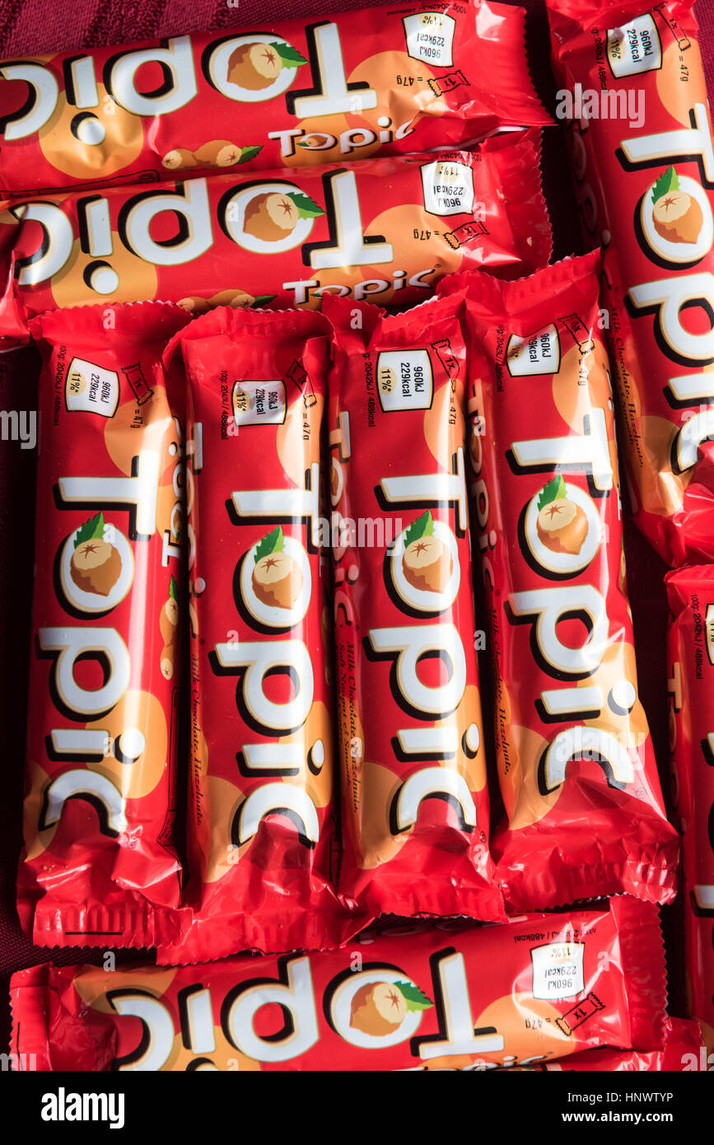
Number of topics (k)
How do we know how many topics we need?
Try different numbers of topics and see what gives a sensible result!
www.cdcs.ed.ac.uk
Notes:
Building capacity in the Digital Humanities
The Digital Research Infrastructure for the Arts and Humanities (DARIAH) aims to enhance and support digitally-enabled research and teaching across the arts and humanities. DARIAH is a network of people, expertise, information, knowledge, content, methods, tools and technologies from its member countries. It develops, maintains and operates an infrastructure in support of ICT-based research practices and sustains researchers in using them to build, analyse and interpret digital resources. By working with communities of practice, DARIAH brings together individual state-of-the-art digital arts and humanities activities and scales their results to a European level. It preserves, provides access to and disseminates research that stems from these collaborations and ensures that best practices, methodological and technical standards are followed.

Slide 84
Number of topics (k)
How do we know how many topics we need?
Try different numbers of topics and see what gives a sensible result!
We can use coherence scores (a measure of the internal similarity of a topic) to evaluate the quality of a topic or collection of topics
www.cdcs.ed.ac.uk
Notes:
Building capacity in the Digital Humanities
The Digital Research Infrastructure for the Arts and Humanities (DARIAH) aims to enhance and support digitally-enabled research and teaching across the arts and humanities. DARIAH is a network of people, expertise, information, knowledge, content, methods, tools and technologies from its member countries. It develops, maintains and operates an infrastructure in support of ICT-based research practices and sustains researchers in using them to build, analyse and interpret digital resources. By working with communities of practice, DARIAH brings together individual state-of-the-art digital arts and humanities activities and scales their results to a European level. It preserves, provides access to and disseminates research that stems from these collaborations and ensures that best practices, methodological and technical standards are followed.

Slide 85
Number of topics (k)
How do we know how many topics we need?
Try different numbers of topics and see what gives a sensible result!
We can use coherence scores (a measure of the internal similarity of a topic) to evaluate the quality of a topic or collection of topics
“…based on the topic's top 15 words and shows how strongly pairs of these top 15 words support each other within the corpus” (Syed & Spruit 2017)
www.cdcs.ed.ac.uk
Notes:
Building capacity in the Digital Humanities
The Digital Research Infrastructure for the Arts and Humanities (DARIAH) aims to enhance and support digitally-enabled research and teaching across the arts and humanities. DARIAH is a network of people, expertise, information, knowledge, content, methods, tools and technologies from its member countries. It develops, maintains and operates an infrastructure in support of ICT-based research practices and sustains researchers in using them to build, analyse and interpret digital resources. By working with communities of practice, DARIAH brings together individual state-of-the-art digital arts and humanities activities and scales their results to a European level. It preserves, provides access to and disseminates research that stems from these collaborations and ensures that best practices, methodological and technical standards are followed.

Slide 86
DEMO 2

Slide 87


Compare to BERTopic…
More pre-processing
Uses only corpus data
Instability
Complexity
www.cdcs.ed.ac.uk
Notes:
Building capacity in the Digital Humanities
The Digital Research Infrastructure for the Arts and Humanities (DARIAH) aims to enhance and support digitally-enabled research and teaching across the arts and humanities. DARIAH is a network of people, expertise, information, knowledge, content, methods, tools and technologies from its member countries. It develops, maintains and operates an infrastructure in support of ICT-based research practices and sustains researchers in using them to build, analyse and interpret digital resources. By working with communities of practice, DARIAH brings together individual state-of-the-art digital arts and humanities activities and scales their results to a European level. It preserves, provides access to and disseminates research that stems from these collaborations and ensures that best practices, methodological and technical standards are followed.

Slide 88
DEMO 3

Slide 89
Thanks Everyone!
Please message me on Teams for office hours!

